Slide 1

Norwood Airlines Data Analysis

Slide 2

Approach -
Airlines, airports and Flights Data uploaded to S3 bucket initially
Airlines, airports and Flights Data copied to SnowFlake using external stage
Views in SnowFlake created for reports
Visualizations created using dataframes in spark by reading data from SnowFlake views
Inferences drawn from either view results or visualizations (spark dataframes or snowsight)

Slide 3
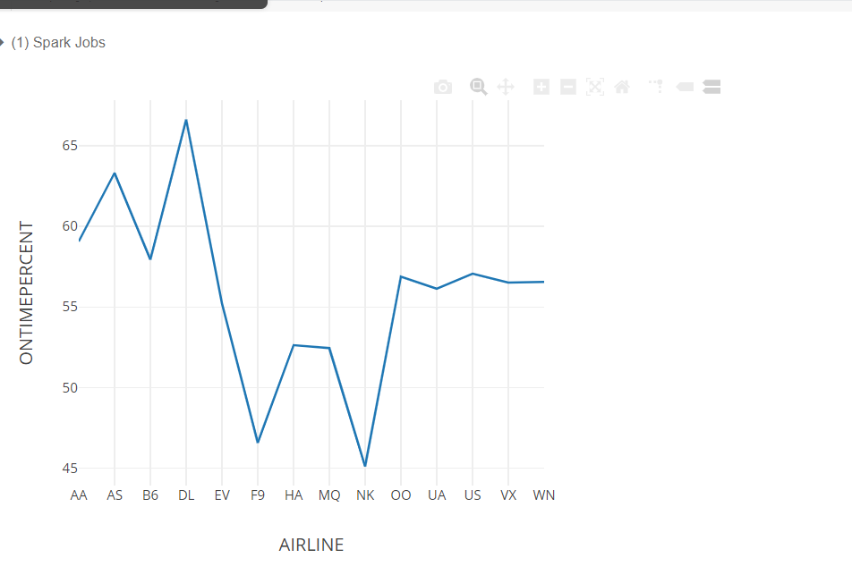
● On time percentage of each airline for the year 2015
Inference : Delta Airlines has highest on time percentage amongst all Airlines in 2015

Slide 4
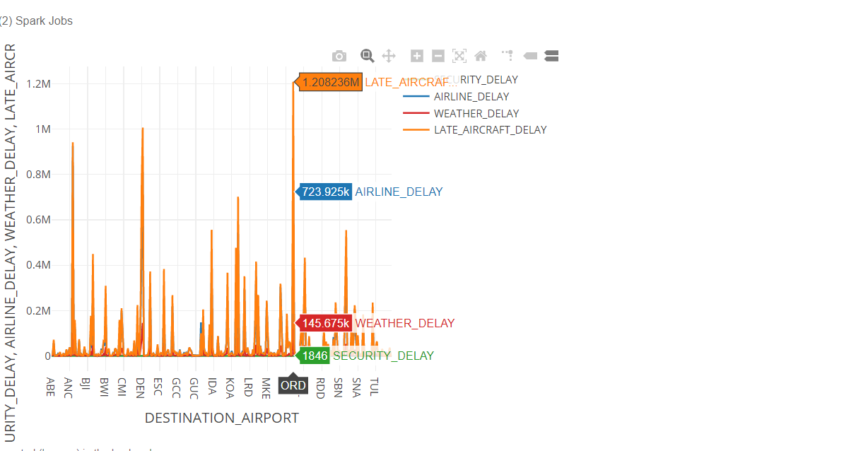
● Delay reasons by airport
Inference : From what is seen above (ORD i.e Chicago O Hare Airport ) seems to have highest delays.

Slide 5
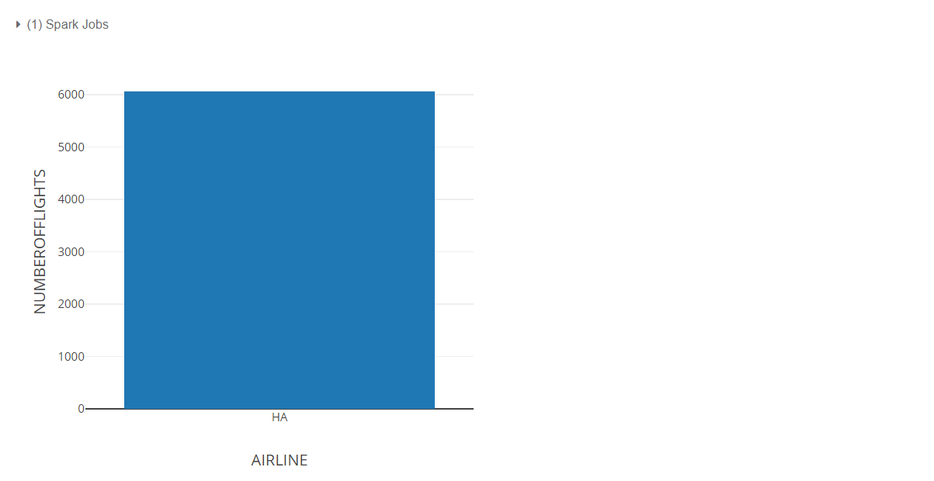
● Airline with the most unique routes
Inference : From what is seen above (HA i.e Hawaiian Airlines Inc) appears to have most unique routes ( 6063 )

Slide 6
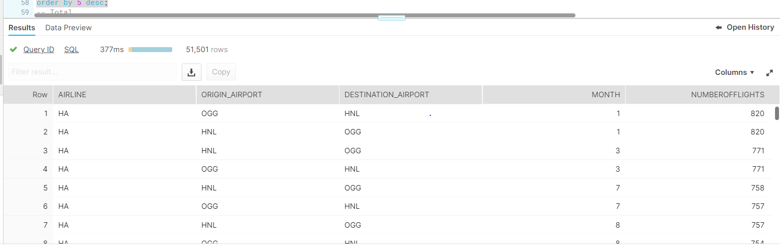
● Total number of flights by airline and airport on a monthly basis
Inference : From what is seen above (HA i.e Hawaiian Airlines Inc) appears to have most flights in a given month from Kahului Airport to Honululu International Airport

Slide 7
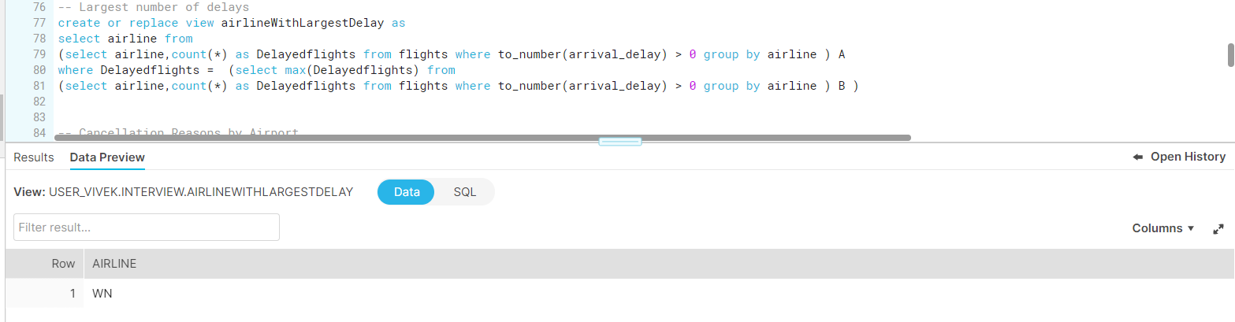
● Airlines with the largest number of delays
Inference : WN ( SouthWest Airlines Co) has largest number of delays

Slide 8
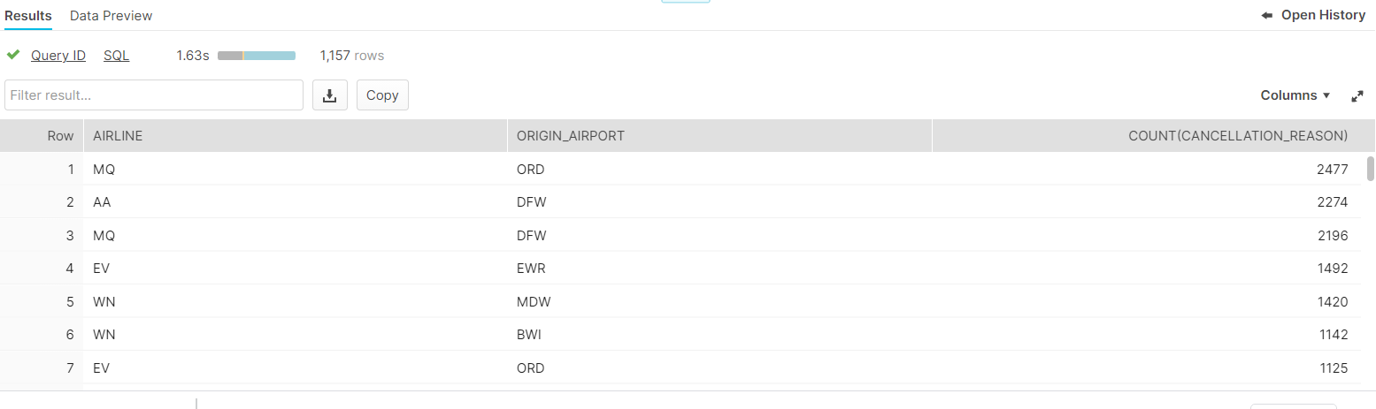
● Cancellation reasons by airport
Query –
select airline, origin_airport, count(cancellation_reason) from cancellationReasonByAirport group by airline, origin_airport order by 3 desc;
Inference : MQ (American Eagle Airlines) from ORD (Chicago Ohare Airport) had most cancellations

